Slide 1

Group No. 12
Education Unlocked

Slide 2
Presented By:-
Swapnil Khare
Under The Supervision of:-
Mr.Anuj Kumar
(Asst. Professor)
Department of CEA
GLA University, Mathura
Mohit Singh
Vishal Kumar
Rishabh Kumar Tripathi
Nitin Singh
Bhupendra kumar

Slide 3
Content
Introduction
Problem Statement
Objectives
Project Scope
Tools and Technology
Conclusion
References

Slide 4
Introduction
Our website “education unlocked“ aims for providing the digital platform for students from where they can get knowledge so that they can excel in their career. Students can conveniently get all the notes of BCA Course at one place and study anytime and anywhere. Also students can get list of top colleges for further studies i.e. MCA along with their links so that they are well informed and make the right choice. Students can also ask their doubts and seek guidance which will be provided with the help of inbuilt chat feature.

Slide 5
Problem Statement
It has always been a tedious process to borrow notes from seniors or teachers. So From this platform they can obtain all subject notes semester wise and study anytime and anywhere.
There is often confusion about whether to opt for higher studies after graduating from BCA and if so then from which college? From our platform students can get list of top colleges along with their links so that they are well informed and make the right choice.

Slide 6
Objectives
Providing knowledge to students so that they can excel in their career.
Reducing time and efforts in arranging and organizing notes.
Allowing students to study anytime anywhere from this online platform.
Provide simple and easy user interface to students.
Giving students a platform to ask their queries and seek guidance.

Slide 7
Project Scope
Simple
Informative
Available 24*7
Free of cost
Useful Chat Feature

Slide 8
Project analysis slide 2
Tools And Technology
HTML
CSS
PHP
SQL
JAVASCRIPT
VISUAL STUDIO CODE

Slide 9
Software Requirements
Browser – Edge, Google Chrome, Mozilla Firefox (Any one).
IDE – VsCode.
Server – XAMPP.

Slide 10
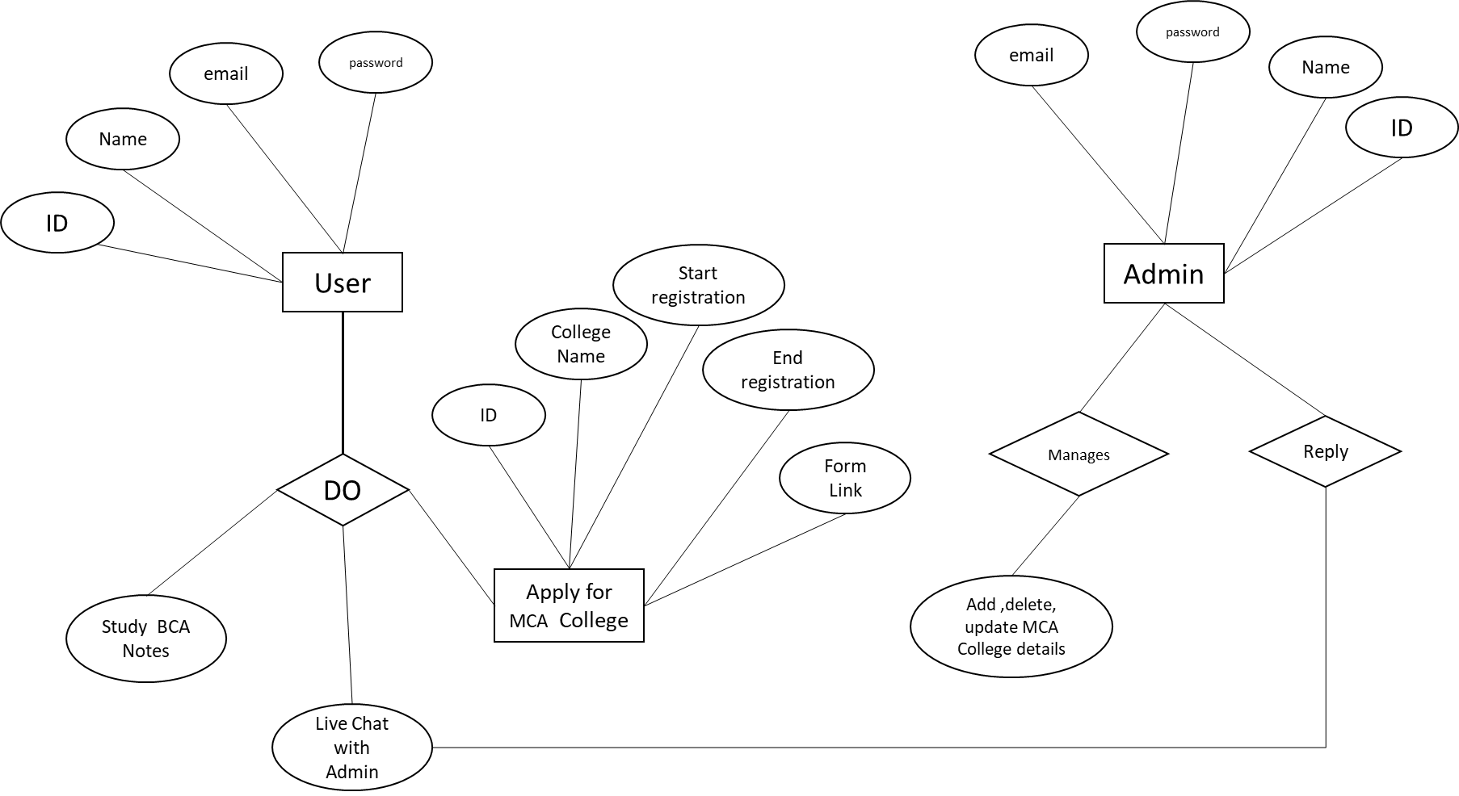
ER Diagram

Slide 11
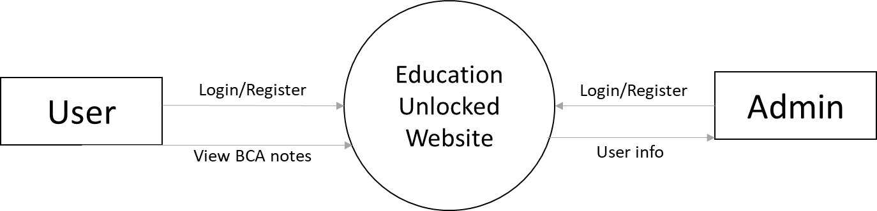
DFD Level 0

Slide 12
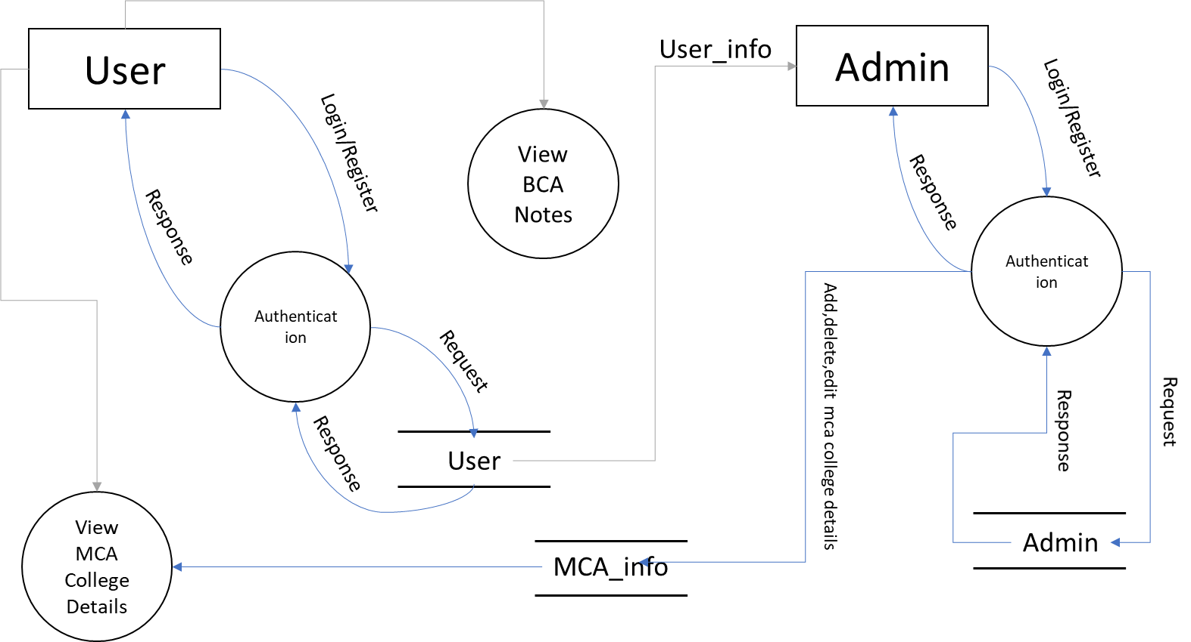
DFD Level 1

Slide 13
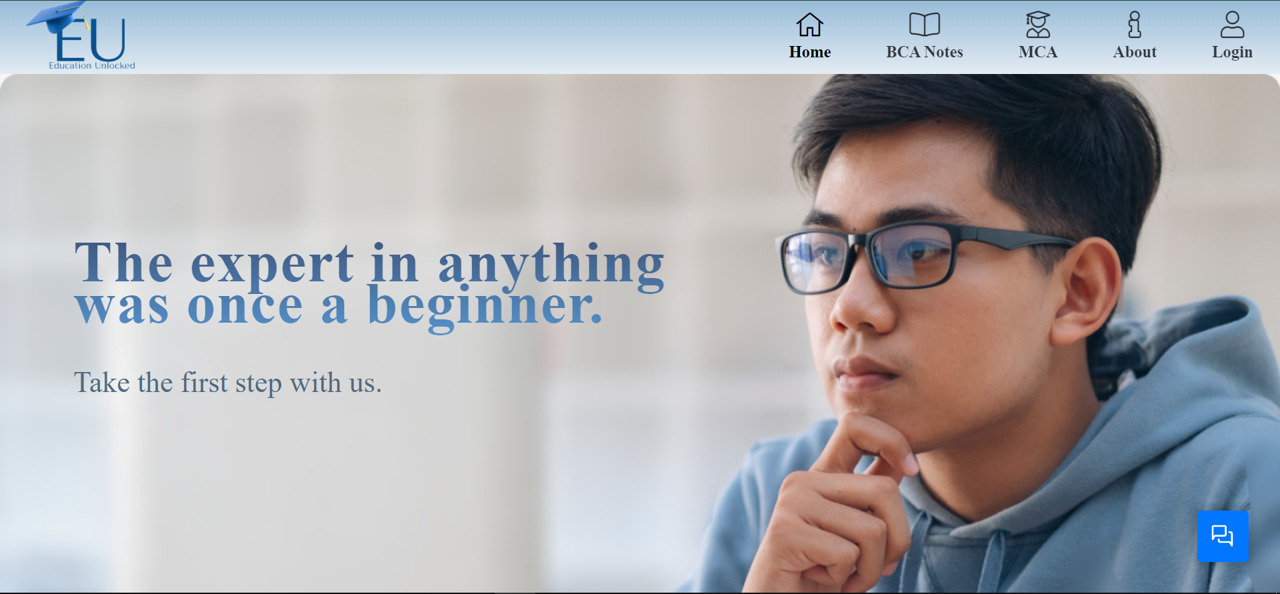
Home Page

Slide 14
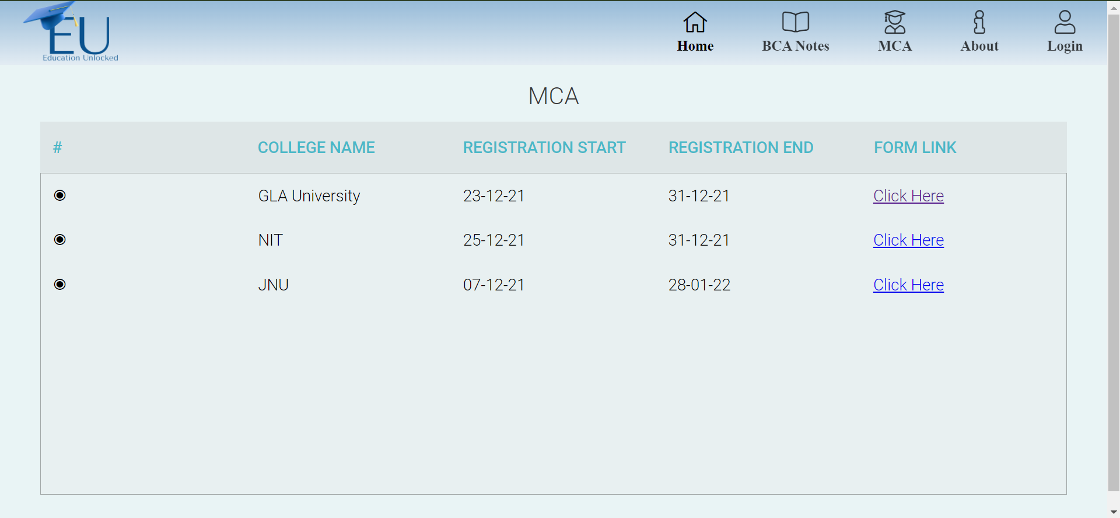
MCA College Details

Slide 15
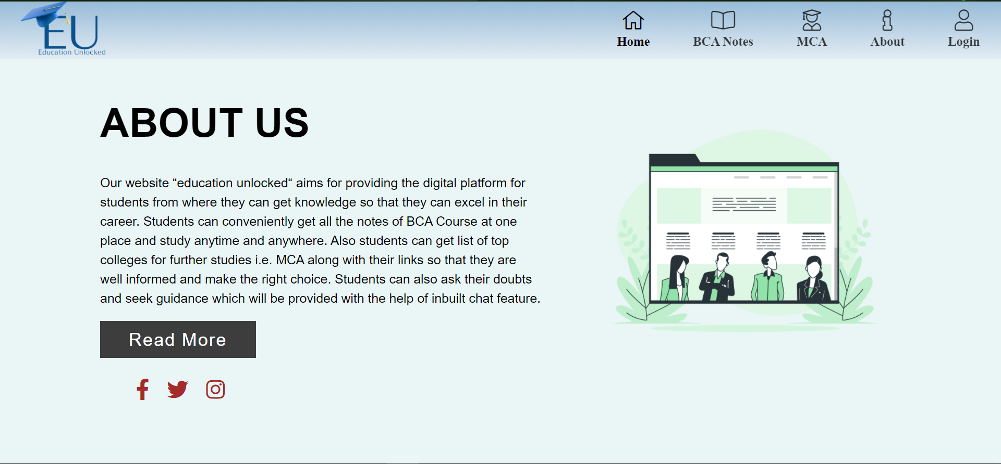
About Us Page

Slide 16
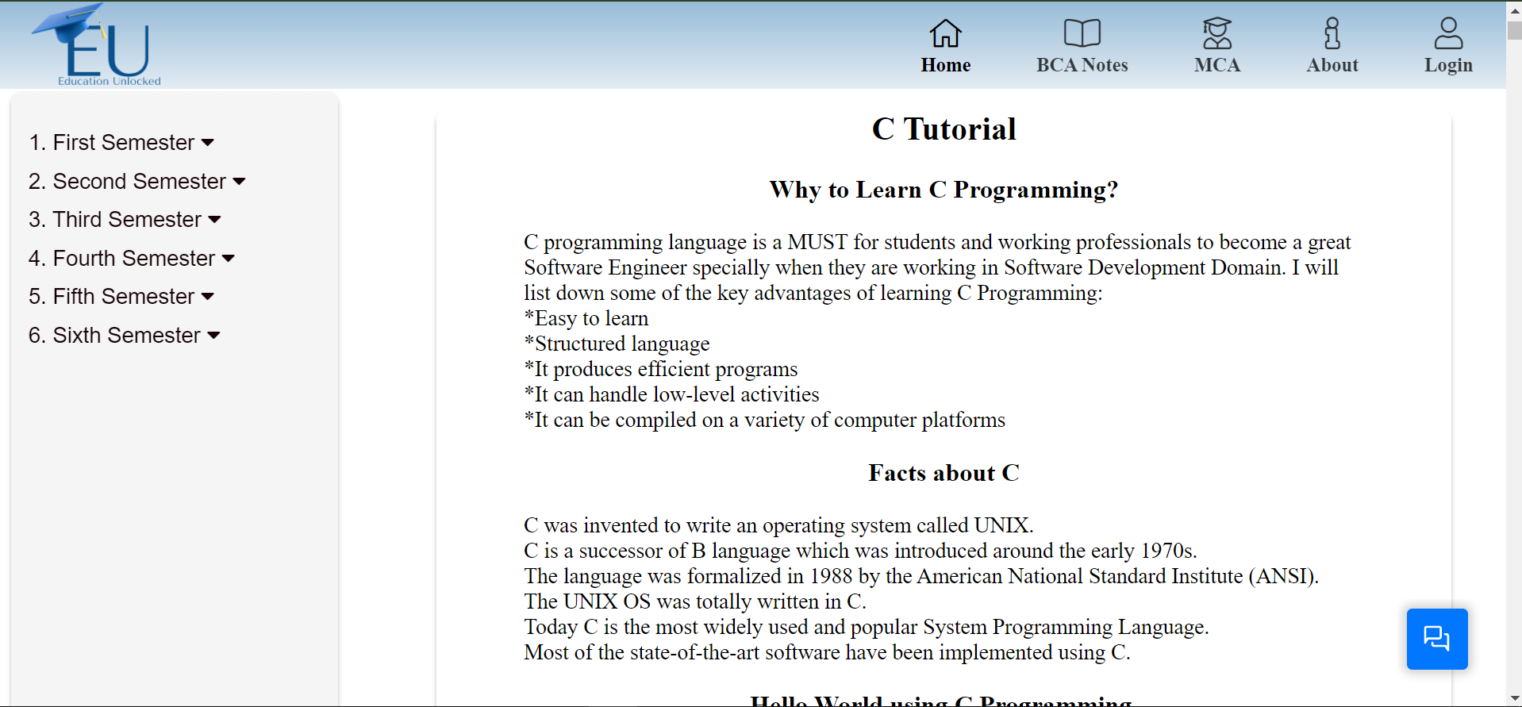
BCA Notes Page

Slide 17
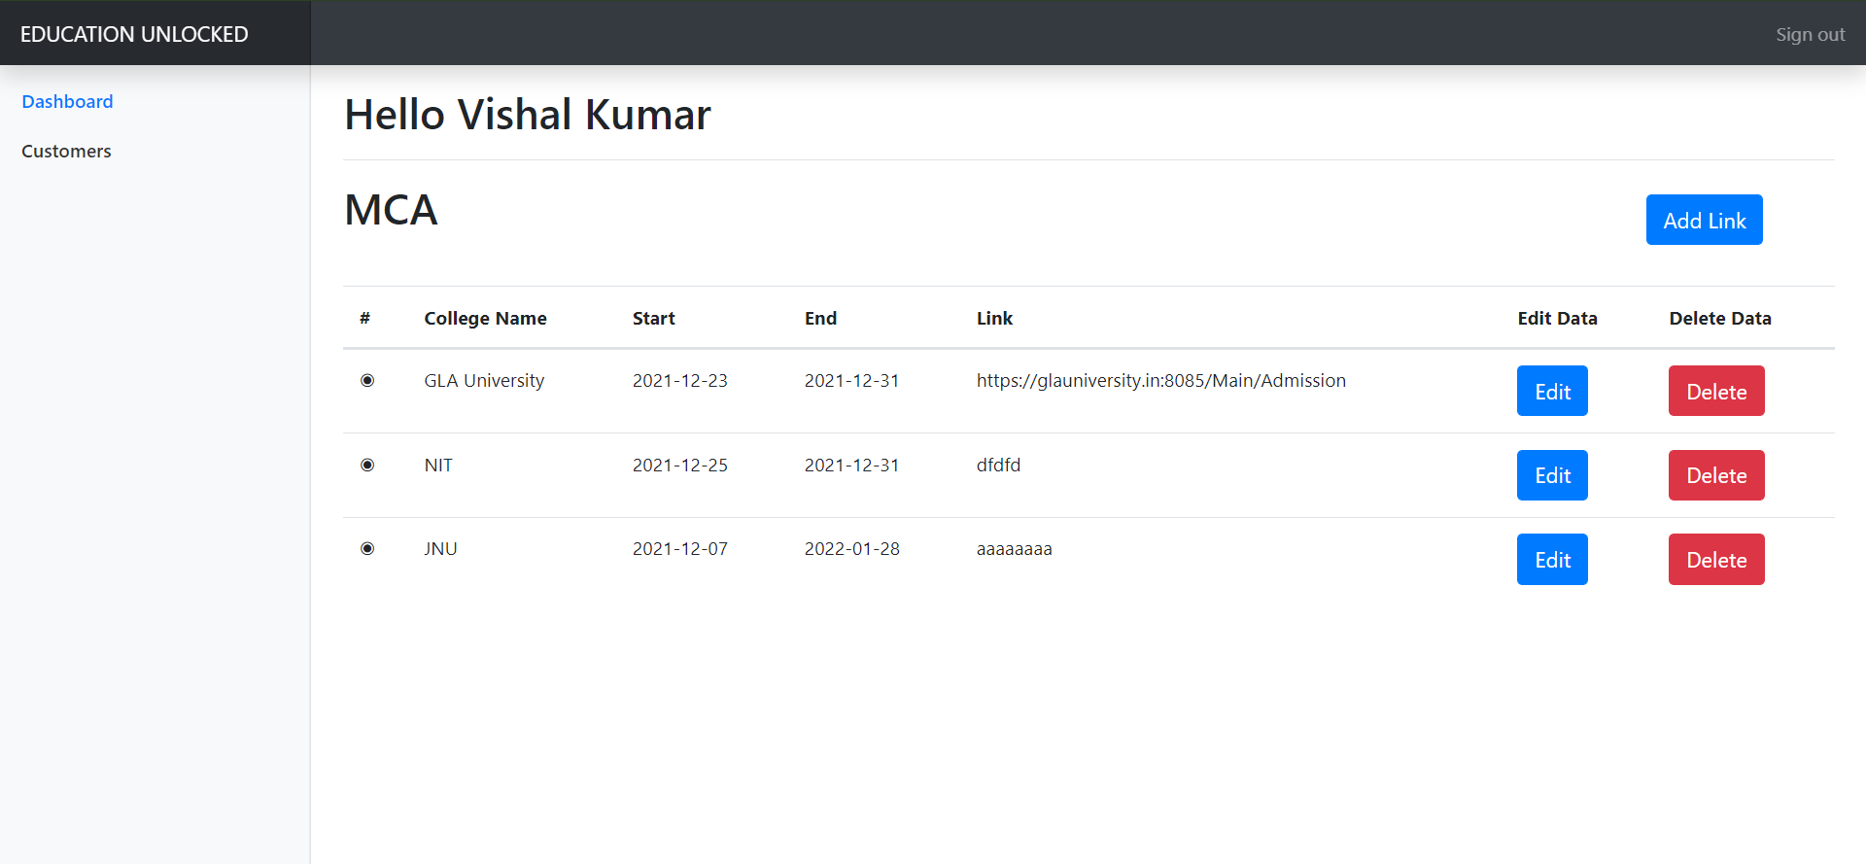
MCA College

Slide 18
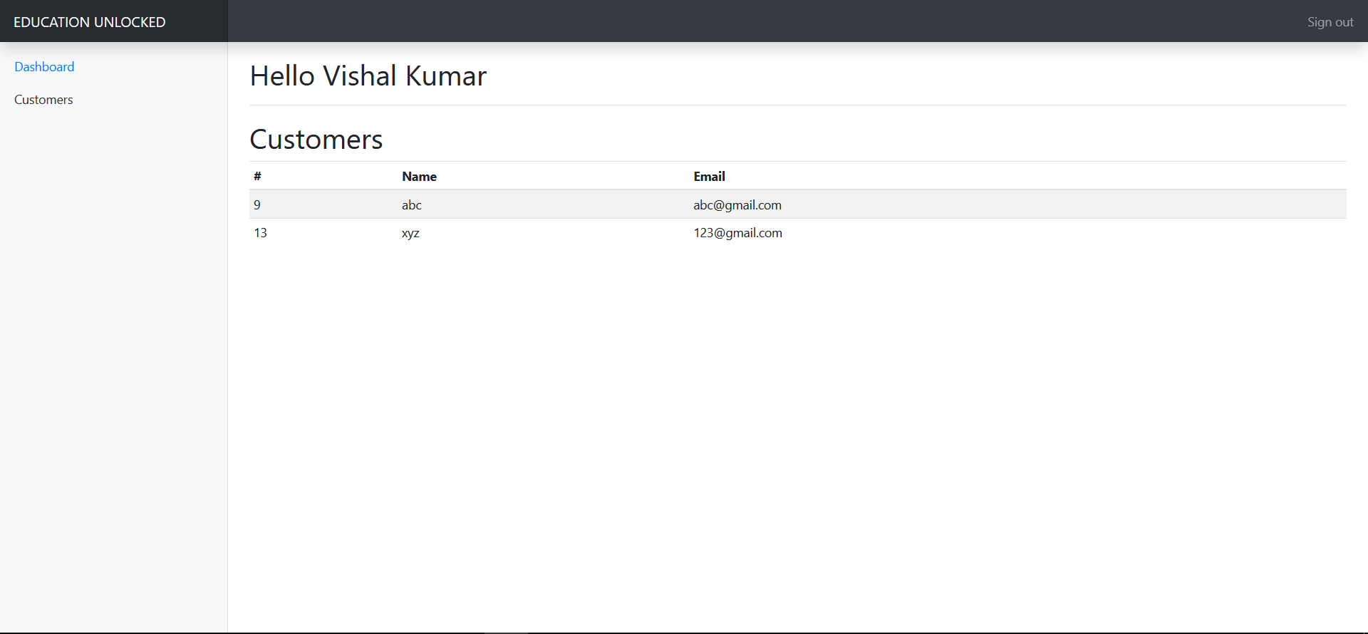
User Details Page

Slide 19
Project analysis slide 3
Conclusion
Our website “Education Unlocked“ is a complete package for students as they can easily get notes and also ask their queries and get answers using the special chat feature.
Along with this they will also get information about good colleges for higher studies i.e., MCA. Thus, paving the way for a successful career.
These all features will be provided in a single platform which will be very beneficial and time saving for students.

Slide 20
Project analysis slide 6
References
www.w3schools.com
www.tutorialspoint.com

Slide 21
Thank You

